Slide 1
Building a Secure Decentralized Chat Application
Team Members
Pallavi Dawn
Raunak Sengupta
Srijani Pal
C. Gautamdev Chawdary

Slide 2

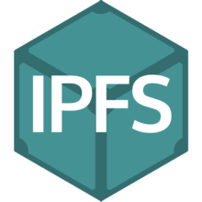
A BRIEF OVERVIEW:
Blockchain and its Advantages.
Buzzword of the current Year! In essence, A distributed ledger.
Multiple peers and shared copy among each.
Decentralized Application and what are they?
Blockchain enabled sites.
No single point of Failure.
Smart Contracts:
Create rules for ownership and state transition functions.
Instead of an API’s, you have Front End-> Smart Contract-> Blockchain.
MetaMask :Cryptocurrency wallet
IPFS –P2p distributed file system.

Slide 3
SCENARIOS WE TACKLED:
Intentions/goals:
Dapps are Relatively new – Learn more about it!
Create a secure Decentralized Application from start to end.
Deploy it on Ethereum .
Utilize the concept of smart contracts and create a Chat Application on existing Dapps logic.
Utilize Remix IDE for deploying and testing contracts through truffle.
Host it on IPFS.

Slide 4
Main Functions involved in Smart Contract:
SendChatMessages()
CreateNewUser()
GetTotalCountMessages()
ReceiveChatMessages()
Kill()
RemoveEmptyMessages()

Slide 5
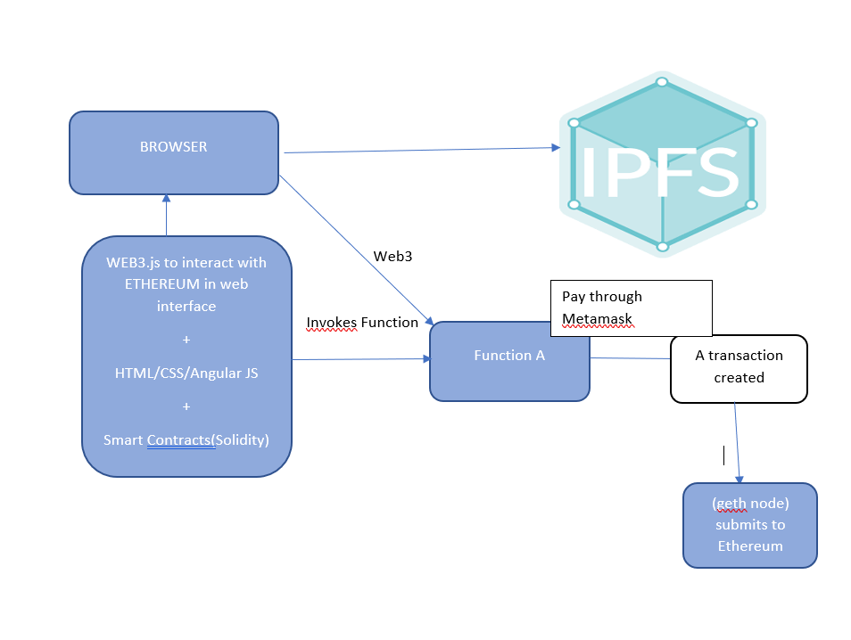
MAJOR COMPONENTS:ARCHITECTURE

Slide 6
Steps involved:
Building the project folder and installation of Truffle.
Writing the Solidity contract for Chat.
Getting the Ropsten API Key.
Getting the wallet from Metamask.
Configuring the Ropsten network and the provider.
Deploying this contract on the Ropsten network.
Connecting the deployed contract with our application.
Deployment of the final application on InterPlanetary File System Host

Slide 7
IMPACT OF THE PROJECT AND FUTURE SCOPE:
Advantage over Centralized Server:
No single server, leads to less overload/attacks.
Single Point of Failures.
Privacy: Only P2P , data stream may be compromised with fellow peers.
Smart Contract and Ethereum prevents this.
Credible transactions through smart contract without third parties.
Demonstrating DDOS on the application

Slide 8
CHALLENGES FACED:
Smart Contracts
Avoid Loopholes in code, can be misused
Remix
Remix IDE: Deploying the contracts .
Hosting
Hosting it on IPFS gateway: Too slow.

Slide 9
RESULTS
Video to give the whole demo of the Chat.

Slide 10
Thank You!

